Slide 1
Fourier transform

Slide 2
Fourier Transform
Fourier Transform reveals which frequency components are present in a given function.
(inverse DFT)
where:
(forward DFT)

Slide 3
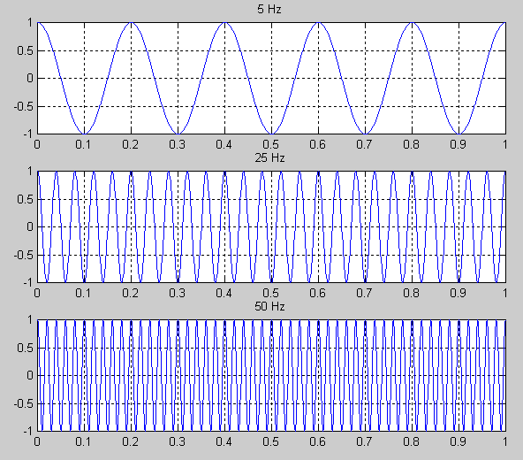
Examples

Slide 4
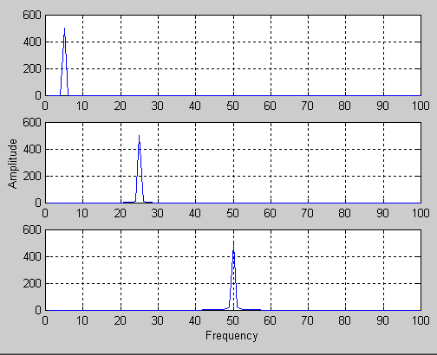
Examples (cont’d)
F₁(u)
F₂(u)
F₃(u)

Slide 5
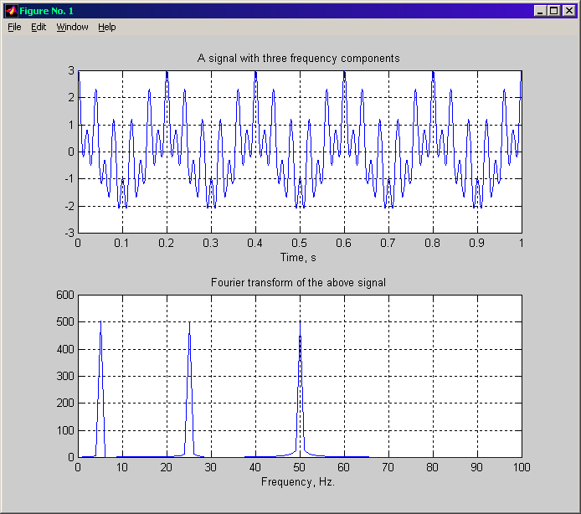
Fourier Analysis – Examples (cont’d)
F₄(u) ?

Slide 6
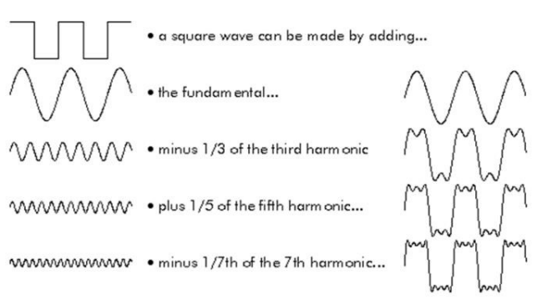
Discrete Fourier transform
Any signal or waveform could be made up just by adding together a series of pure tones (sine waves) with appropriate amplitude and phase Fourier's theorem assumes we add sine waves of infinite duration

Slide 7
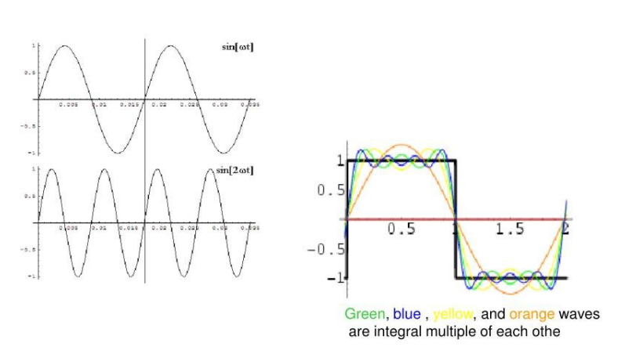
Discrete Fourier transform
Every next wave is the integral multiple of the fundamental wave. What does that mean?
It means: every next wave has an integral multiple frequency of the fundamental wave, ex. w, 2w, 3w, 4w, ..., nw.

Slide 8
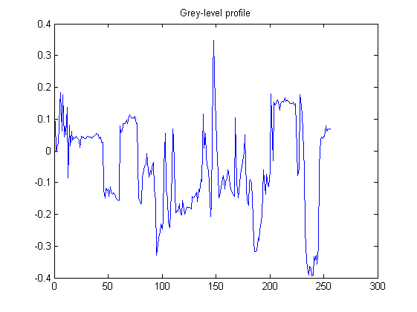
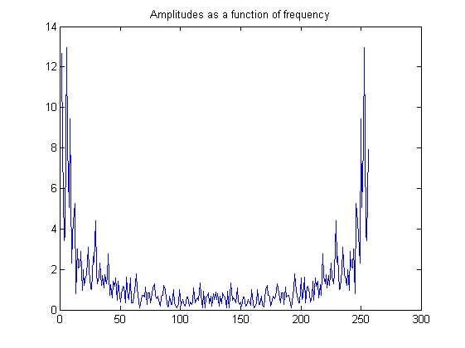
Representing discontinuities or sharp corners (cont’d)
FT

Slide 9
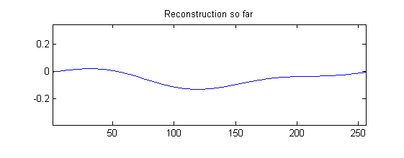
Representing discontinuities or sharp corners (cont’d)
Original
Reconstructed
1

Slide 10
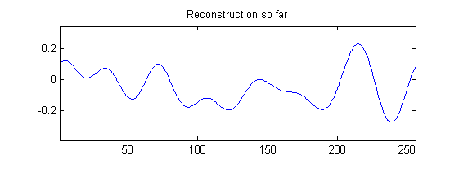
Representing discontinuities or sharp corners (cont’d)
Original
Reconstructed
7

Slide 11
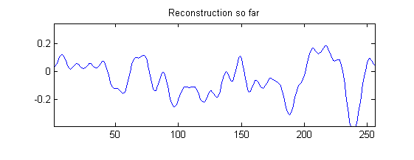
Representing discontinuities or sharp corners (cont’d)
Original
Reconstructed
23

Slide 12
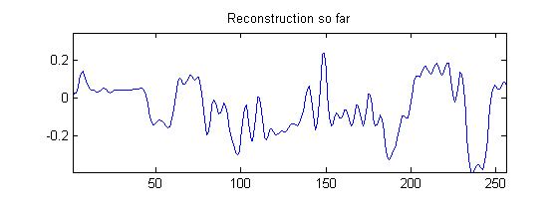
Representing discontinuities or sharp corners (cont’d)
Original
Reconstructed
39

Slide 13
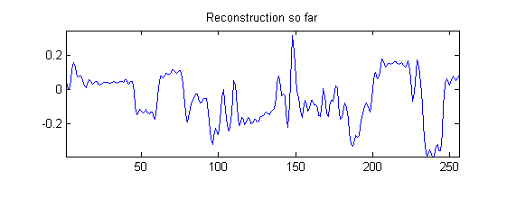
Representing discontinuities or sharp corners (cont’d)
Original
Reconstructed
128 coefficients
63

Slide 14
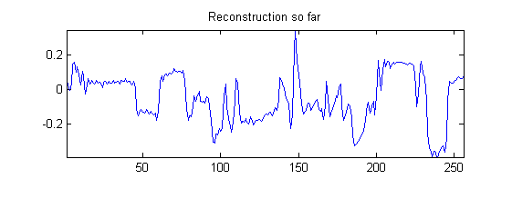
Representing discontinuities or sharp corners (cont’d)
Original
Reconstructed
95

Slide 15
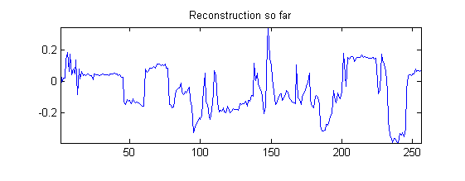
Representing discontinuities or sharp corners (cont’d)
Original
Reconstructed
127
A large number of Fourier components is needed to represent discontinuities.

Slide 16
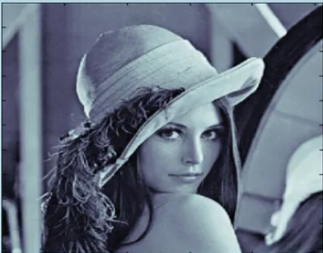
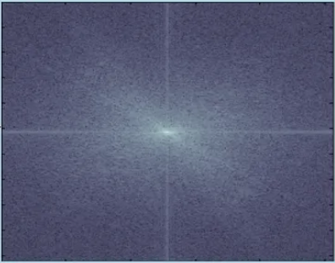
Fourier transform on images
Fourier transform
Spatial domain
Frequency domain

Slide 17

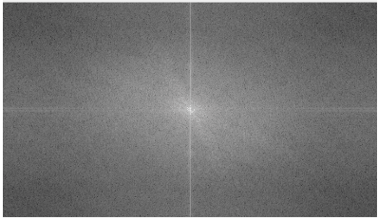
Fourier transform on images
Fourier transform
Spatial domain
Frequency domain

Slide 18
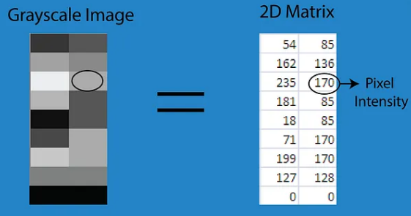
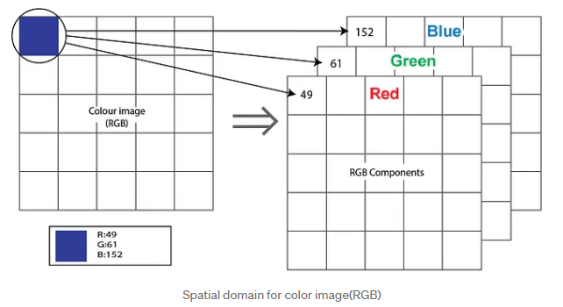
Spatial Domain
An image can be represented in the form of a 2D matrix where each element of the matrix represents pixel intensity.

Slide 19
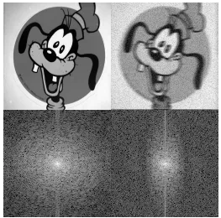
Frequency Domain
In frequency-domain methods are based on Fourier Transform of an image. Roughly, the term frequency in an image tells about the rate of change of pixel values.

Slide 20
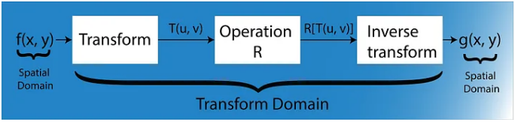
Why Frequency Domain?
Many times image processing task is best performed in other domain than spatial domain.

